Slide 1
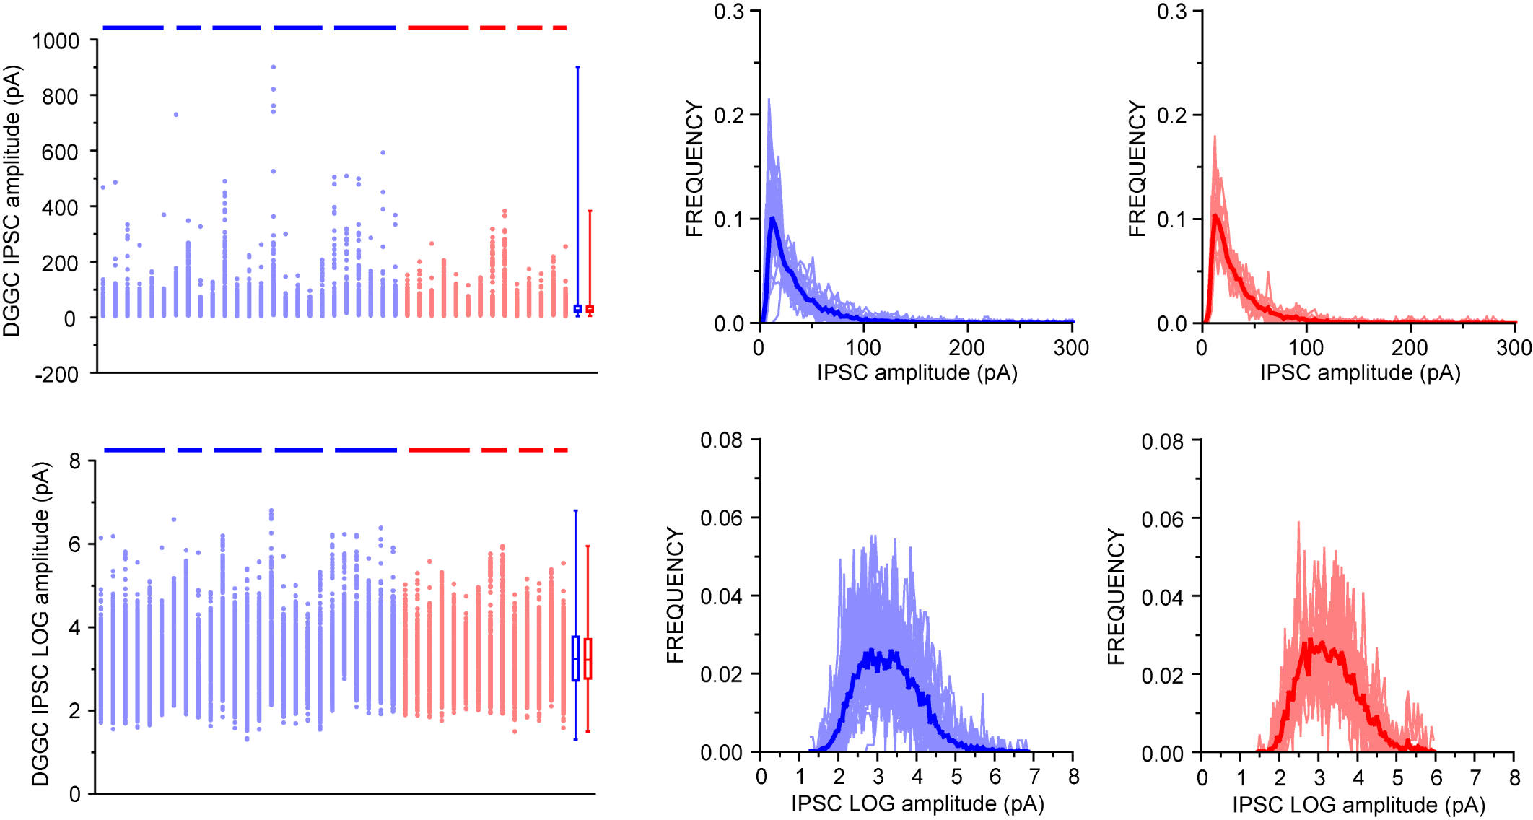
DGGC IPSC amplitude

Slide 2
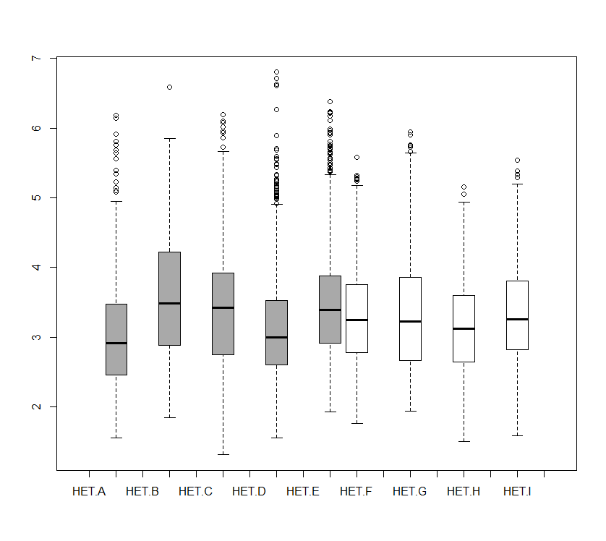
DGGC IPSC amplitude
DGGC LOG IPSC amplitude per mouse (WT: grey, HET: white)

Slide 3
DGGC IPSC amplitude
χ²(1) = 0.06, p = 0.80

Slide 4
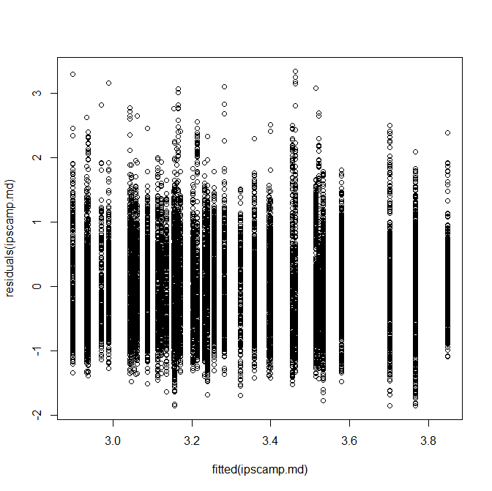
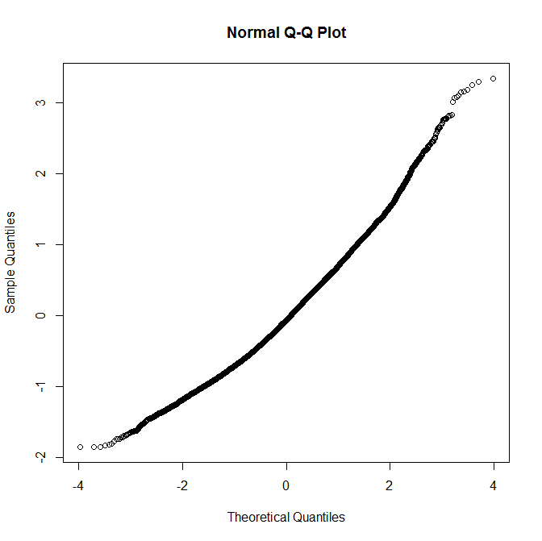
DGGC IPSC amplitude

Slide 5
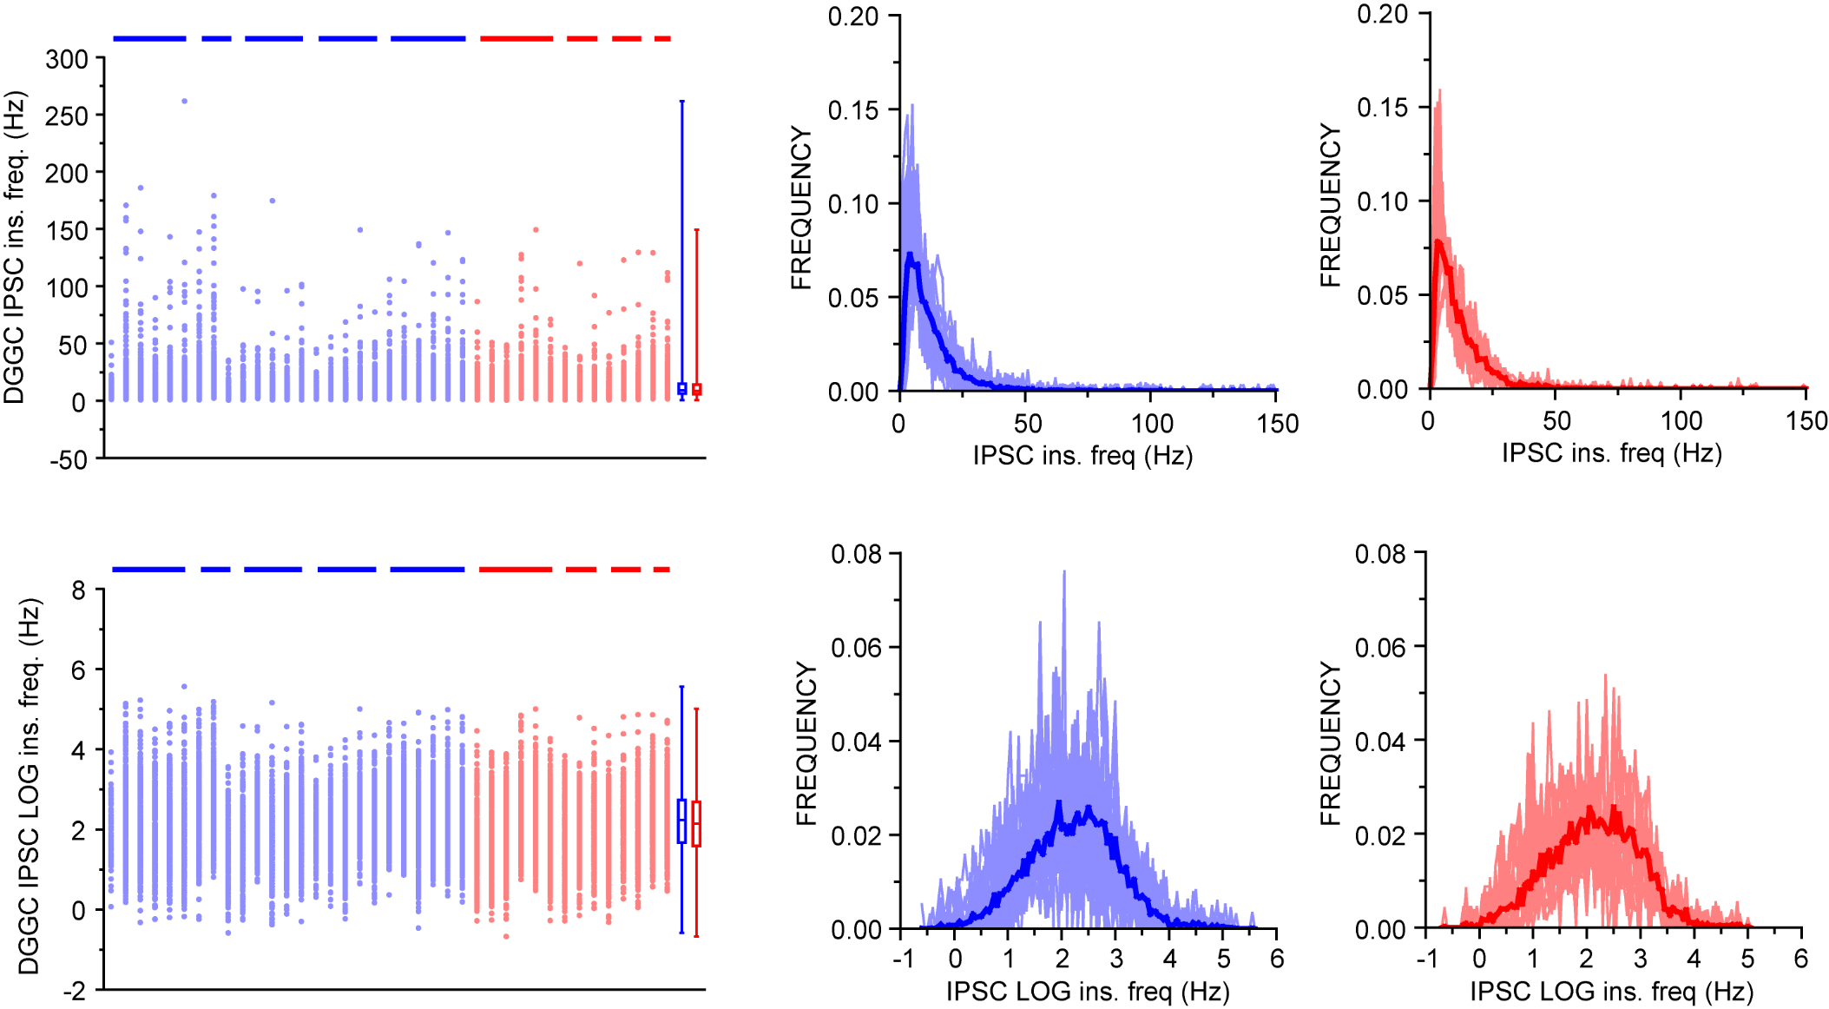
DGGC IPSC frequency

Slide 6
DGGC IPSC frequency
χ²(1) = 0.68, p = 0.41

Slide 7
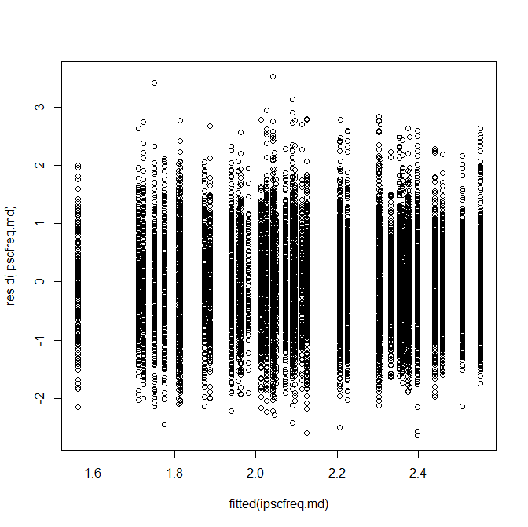
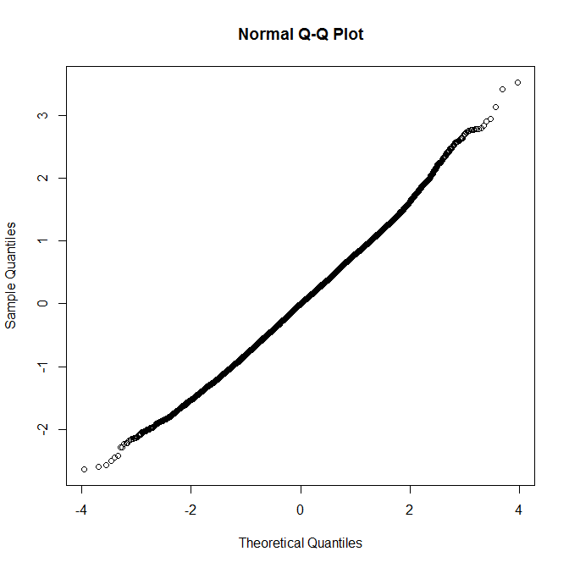
DGGC IPSC frequency

Slide 8
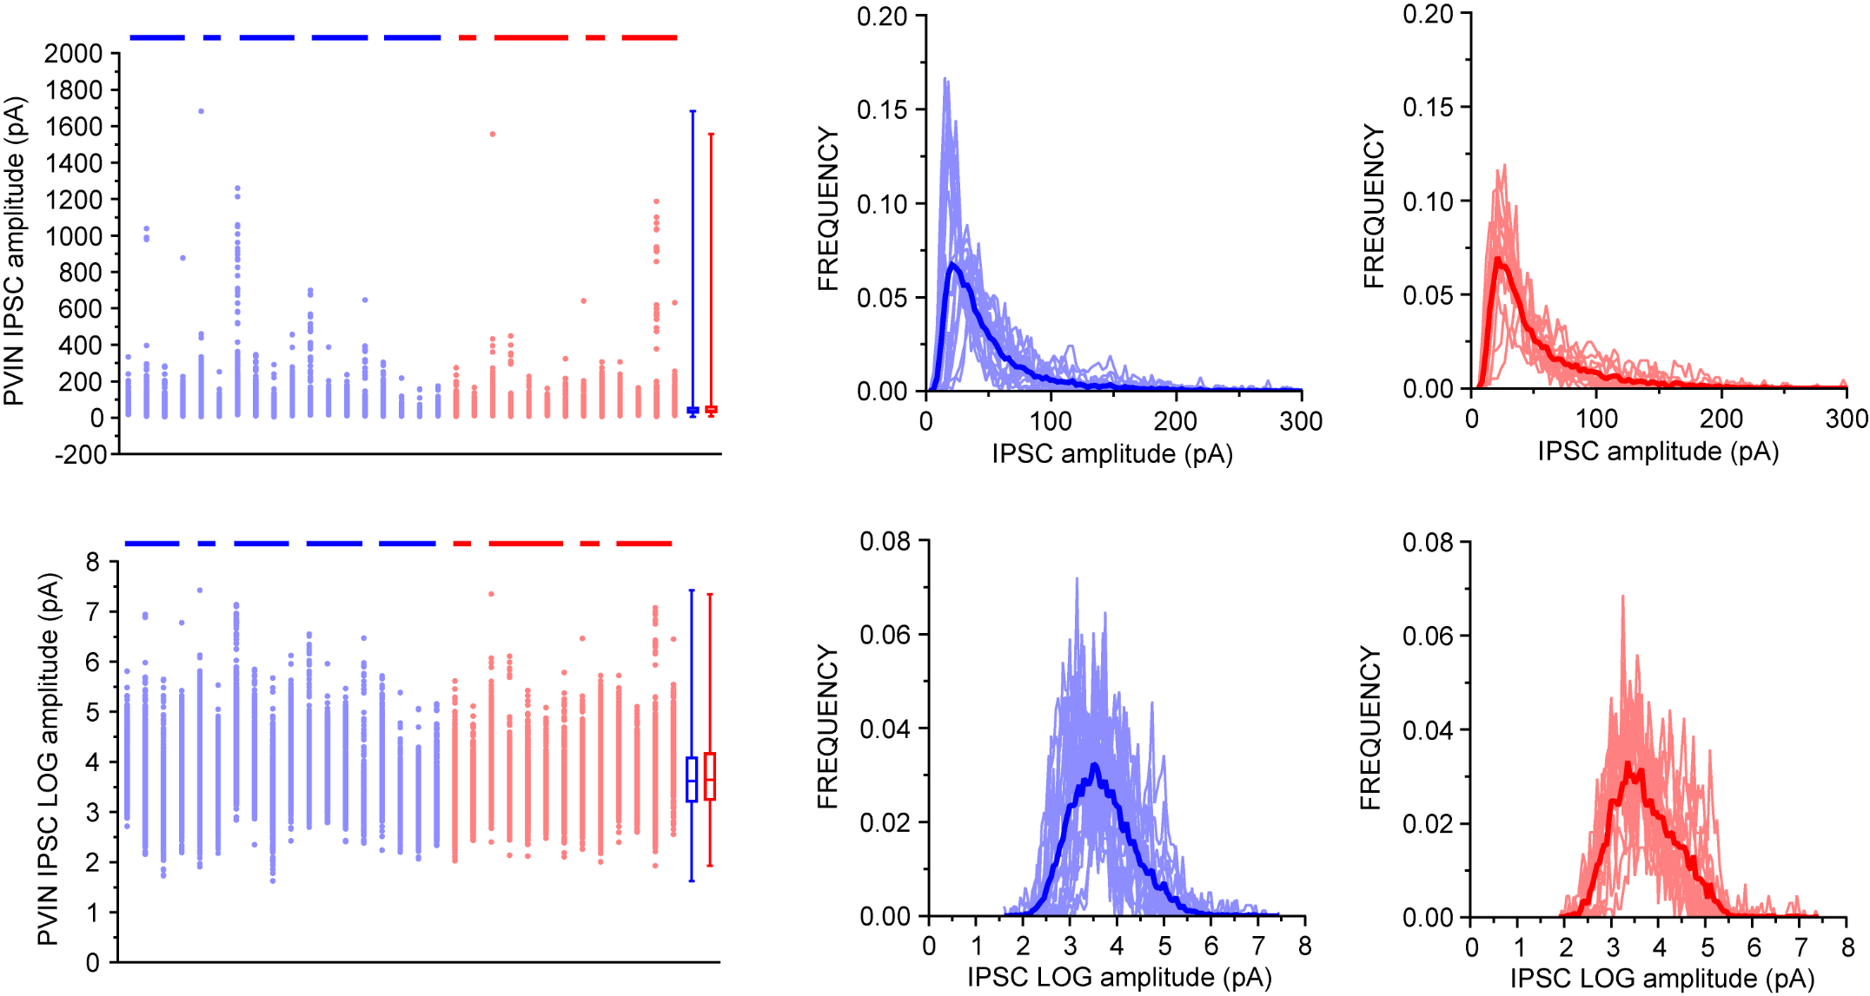
PVIN IPSC amplitude

Slide 9
PVIN IPSC amplitude
χ²(1) = 0.03, p = 0.86

Slide 10
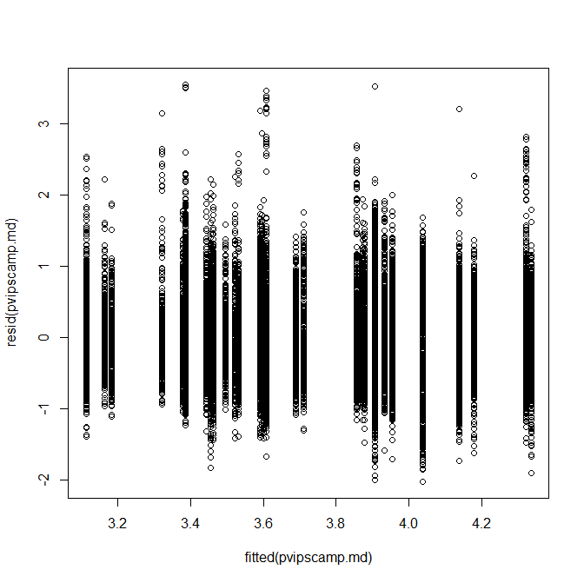
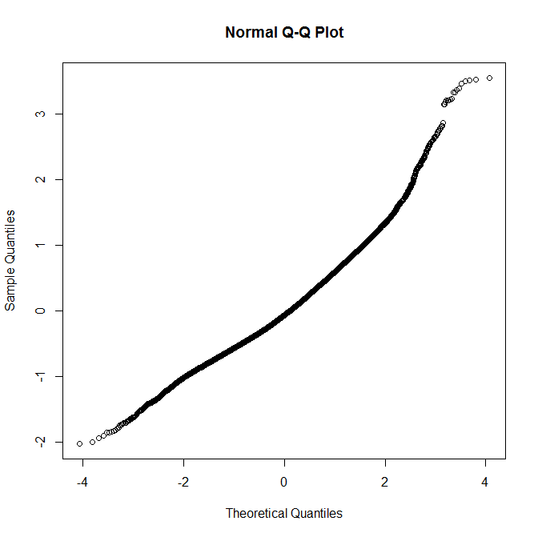
PVIN IPSC amplitude

Slide 11
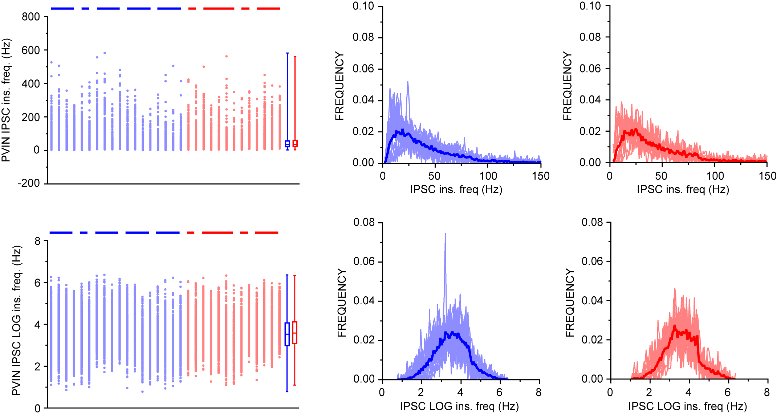
PVIN IPSC frequency

Slide 12
PVIN IPSC frequency
χ²(1) = 0.88, p = 0.35

Slide 13
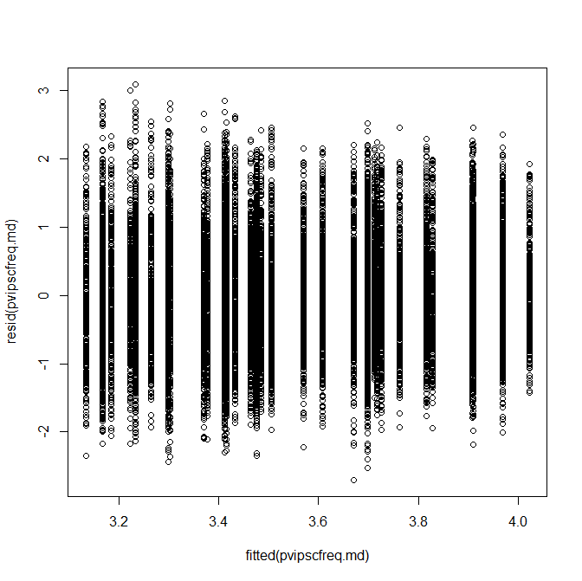
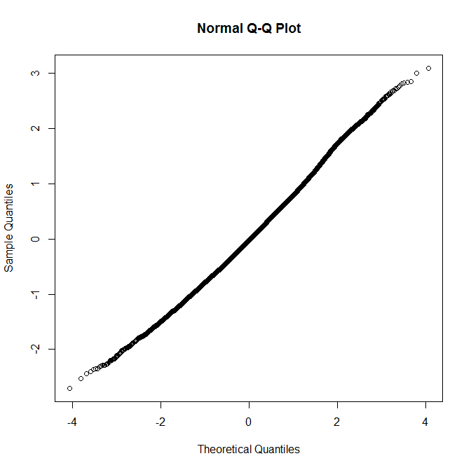
PVIN IPSC frequency

